Slide 1
Notes:
Good morning. My dear teachers and colleague. This is a special presentation in this morning meeting. Because I am goning to sapporo city in japan and have the oral presentation in the annual meeting of japan society of hematology in this october. Therefore I would like to practice presentation in english and please feed me back some comment or suggestion. Thank you very much

Slide 2
DLBCL of the elderly in age older than life expectancy the single institute experience in Taiwan
Sheng Hsuan,Chien, MD
Division of Hematology and Oncology,
Department of medicine, Taipei Veteran General Hospital
National Yang-Ming University School of medicine, Taipei, Taiwan
Notes:
Good morning, ladies and gentleman. Thank you all for coming. My name is Chien, Sheng-Hsuan. I am currently medical doctor in Taipei Veteran General Hospital in Taiwan. It my great pleasure to be here and present our research finding to you. Today, I m going to give a talk on the DLBCL of the elderly patient in the age older than life expectancy and share our experience in Taiwan

Slide 3
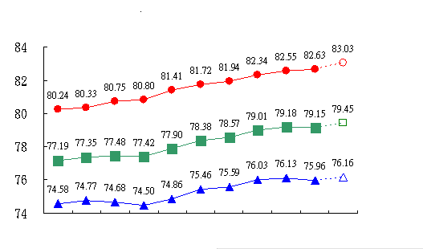
Life expectancy in Taiwan
Life expectancy in Taiwan from 2002-2012
Years- old
Female
All
Male
2002 2003 2004 2005 2006 2007 2008 2009 2010 2011 2012
Statistics Department, Ministry of The Inferior, Taiwan, 2013
Notes:
This is the life expectancy in Taiwan. On two thousand and two, the life expectancy is seventy-seven years old, then it makes progress to nearly eighty years old on twenty twelve. The life expectancy is increasing with time .

Slide 4
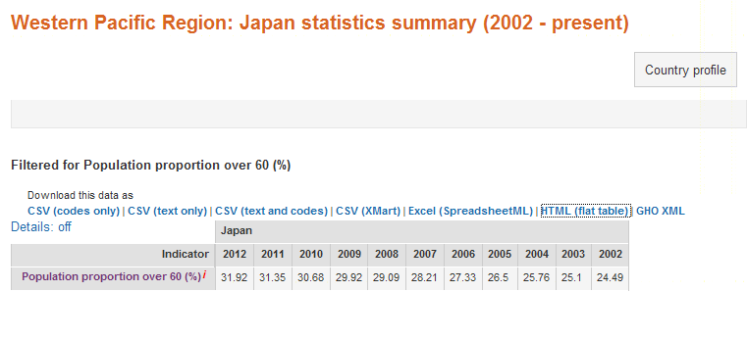
Age over 60 in Japan
World Health Organization, Global Health Observatory repository

Slide 5
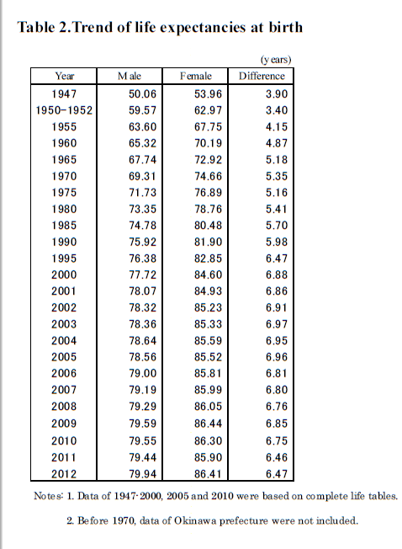
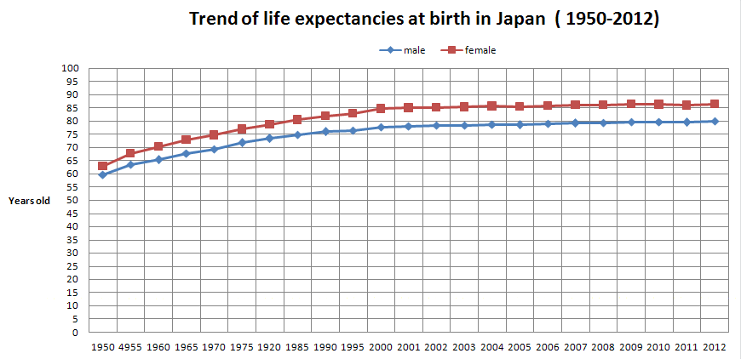
Statistics and Information Department Minister's Secretariat Ministry of Health, Labour and Welfare JAPAN
Notes:
Lets move on to Japan. This is the trend of life expectancy at birth in Japan and its also increasing withtime. No matter in Taiwan or Japan, what we need to face up to is the aging population.

Slide 6
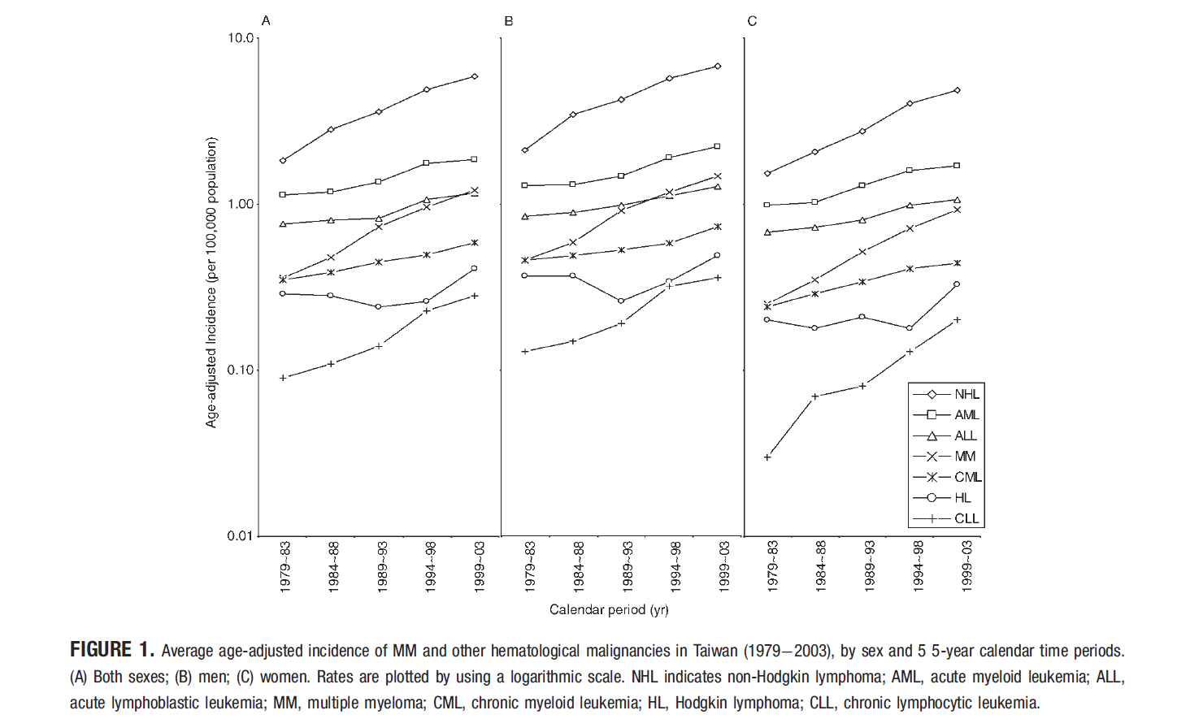
Cancer. 2007 Aug 15;110(4):896-905.
Notes:
On the other hand, The incidence of Non-hodgkin lymphma is also increased with time. As this literature reviewed

Slide 7
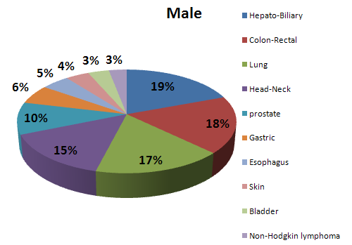
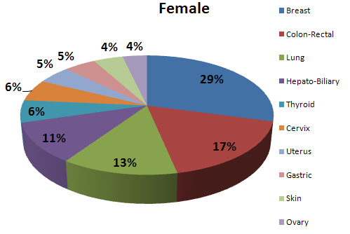
Top 10 cancer in 2009, Taiwan
Notes:
So far, in two thousands and nine, Non-hodgkin lymphoma has been one of the top 10 cancer in Taiwan. As we know, the diffuse large B cell lymphoma is the most popular subtype in Non-hodgkin lymphoma. So, DLBCL with very elderly patients, especially more than 80 years old may be more and more in our daily practice in the future

Slide 8
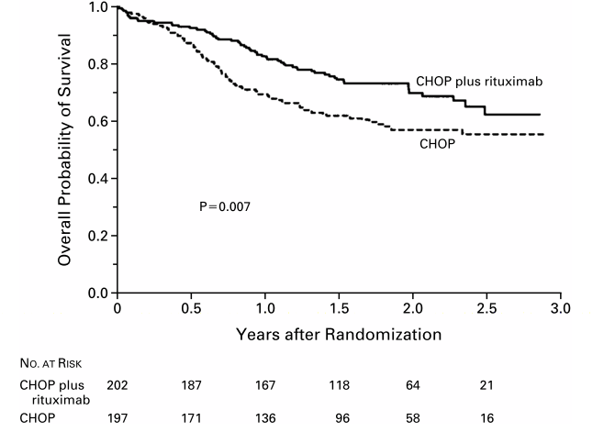
Age in 60-80 years-old
Groupe d’Etude des Lymphomes de l’Adulte study in patients 60 to 80 years old
N Engl J Med, Vol. 346, No. 4
Notes:
R-CHOP is well known for an effective regimen to DLBCL. However, by the initial clinical trial, the application of it is limited to sixty to eighty years old patients. As for patients older than eighty years old , there are no solid evidence to guide how to treat.

Slide 9
Difficult in treating very elderly (age ≥ 80yrs) NHL
Multiple co-morbid illness
Decreased portal/renal perfusion flow
Altered pharmacokinetics
Decreased bone marrow hematopioetic reserve
Poor compliance and tolerance
Exclude in clinical trial, no available guideline
Westin EH ,et al . Semin Oncol 2004; 31: 198–205.
Notes:
Besides, there are many difficult in treating these very elderly patients, such as multiple co-morbidity illness, chronic liver or renal disease, altered pharmacoinetics, decreased marrow reserve and poor compliance or tolerance. The most important of all is these patients are usually exclude by current available trial.

Slide 10
Aims of study
Clinical and laboratory features of very elderly patients with DLBCL in Taiwan
Treatments, responses and Toxicities
Prognostic factors
Survival analysis
Notes:
In order to deal with this problem, we conducted a retrospective study. We reviewed clinical and laboratory features of these very elderly patients in Taiwan, treatment, response and toxicities, and prognostic factor in survival analysis

Slide 11
Patients and methods
Newly diagnosed DLBCL, NOS in Taipei Veteran General Hospital
Age ≧80 years old, from 2000 to 2012
Parameters collected at diagnosis:
ECOG PS, Ann Arbor stage, LDH, WBC, Hb, albumin, LVEF, aaIPI score
Comorbidities record as Charlson score
Notes:
We collected the newly diagnosed diffuse large b cell lymphoma not otherwise specified in Taipei Veteran General hospital, age older than 80 years old from two thousand to twenty twelve and included parameters such asECOG, ann arbor stage, LDH, white cell count, hemoglobulin, albumin, ejection fraction and age-adjusted international prognostic index score. The comorbidities is evaluated by charlson score

Slide 12
Patients and methods
Immuno-chemotherapy
Rituximab or Anthracycline contained or not
5 common regimens: R only, COP, CHOP, R-COP,
R-CHOP
Definition of treatment competence
Intent to treatment (ITT):
received any systemic chemotherapy
Early treatment failure (ETF):
treatment < 3 cycles
Per-protocol treatment (PPT):
treatment ≥ 3 cycles
Receiving Immuno-Chemotherapy cycle versus patient subgroups
Notes:
The treatment are divided into five common regimen according to rituximab or anthracycline contained or not. For example, R-CHOP indicated the rutuximab, cyclophosphamide, hydroxydaunorubicin, oncovin, prednisolone while the cop is combined by only cyclophosphamide, oncovin and prednisolone.
Next we also divided patents into three subgroups according to the treatment competence. Those who received any systemic chemotheapy are intent to treatment group. If patients received less than three cycles of chemotherapy, it would be regarded as regarded as early treatment failure. The others patients who received more than 3 cycles of chemotherapy are per-protocol treatment group . We also analyzed the cycles of immuno-chemotherapy versus patients group

Slide 13
Patients and methods
Response according to International Workshop of response criteria for NHL established in 1999
Toxicities according to NCI CTC (version 3.0)
Statistical analysis
Chi-square test for categorical variable
Kaplan-Meier method for survival and curves compared using log-rank
Cox-regression for multivarite anaylsis
Receiving Immuno-Chemotherapy cycle versus patient groups
Notes:
Response and toxicities are evaluated by international standard criteria. Chi-square, kaplan-meier, and cox regression are applied for statistical analysis. We also analyzed the cycles of immuno-chemotherapy versus patients group.
National Cancer institute common toxicity criteria grading system (version 3.0)

Slide 14
Results
Notes:
Now lets turn on the result

Slide 15
Result
183 patients in single was conducted in in Taipei Veteran General Hospital
Median age: 84.2 years old
67% of patients had high age-adjusted International Prognostic Index (≥2)
33 % of patents had high Charlson comorbidity Index scores (>8)
Notes:
There are one hundred and eighty-three patients included. The median age is eighty-four ponit 2 years old. Sixty-seven percent of patients had higher aaIPI score and thirty-three percent had higer charlson score

Slide 16
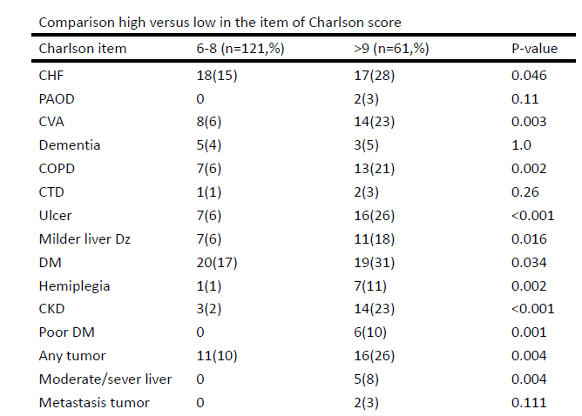
Characteristics in morbidities
High proportion in
high Charlson score(>9)
Congestive heart failure
Cerebrovascular accident
Chronic obstructive pulmonary disease
Ulcer
Liver disease
Diabetic mellitus
Any tumor

Slide 17
Treatment subgroups
Cases enrolled
(n=183)
Without treatment*
(n=28)(15%)
Intent to treatment (ITT)
(n=155) (85%)
Early treatment failure
(Cycles<3,n=44)
(24% of all)
(28% of ITT)
Per protocol treatment
(Cycles≧3,n=111)
(61% of all)
(72% of ITT)
* Included operation only (2) and radiation only (3)
Notes:
This is the treatment subgroups, one hundred and eighty-three patients are enrolled and there are twenty-eight patients, account for fifteen percent of all are no treatment. The other one hundred and fifty-five patients are intent to treatment group. Among these group, forty-four patients receiving less than three cycles of chemotherapy are early treatment failure and the others receving more or equal to three cycles of chemotherapy are per-protocol treatment group.
In no treatment , 3 R/T alone, 2 operation alone

Slide 18
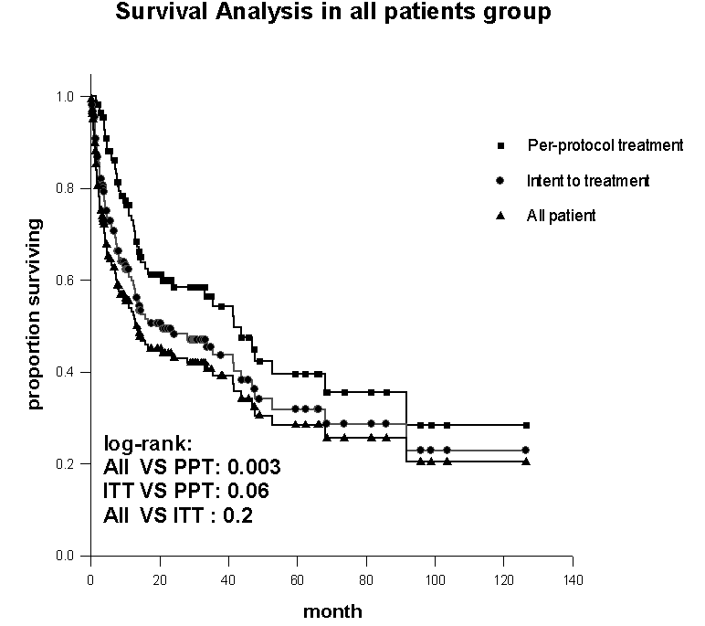
Survival in each group
Media survival
14.2 months
10.3 months
7.7 months
Notes:
This is the survival curve in these three groups. The median survival in per-protocol treatment, intent to treatment and all patients is fourteen, ten seven months. Respectively

Slide 19
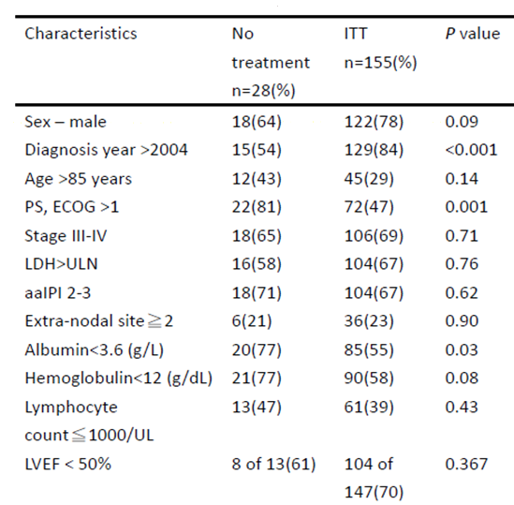
Characteristics in No treatment VS Intent to treatment
High proportion in
No Treatment group
Diagnosis before 2004
PS, ECOG> 1
Hypoalbuminemia
Notes:
Let us move on to characteristics in the no treatment versus intent to treatment. those who did not receive systemic therapy had significantly higher proportions of their diagnosis before two thousand and four, poor performance, and hypoalbuminemia

Slide 20
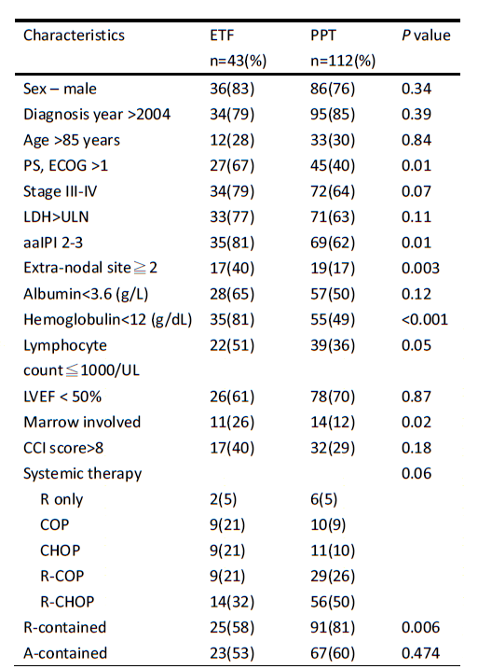
Characteristic in early treatment faiulre VS per-protocol treatment
High proportion in
early Treatment failure
PS, ECOG>1
aaIPI:2-3
Extra-nodal involved > 2
Anemia < 12
Marrow involved
Less R contained therapy
Notes:
Next we compare the early treatment failure versus per-protocol treatment. Early treatment failure had the higher proportion in poor PS, higher aaIPI scores, more sites of extra-nodal involvement, hypoalbuminemia, anemia, bone marrow involvement and less Rituximab contained therapy. In terms of the comorbidities, the charlson scores was not statistically different in these three groups

Slide 21
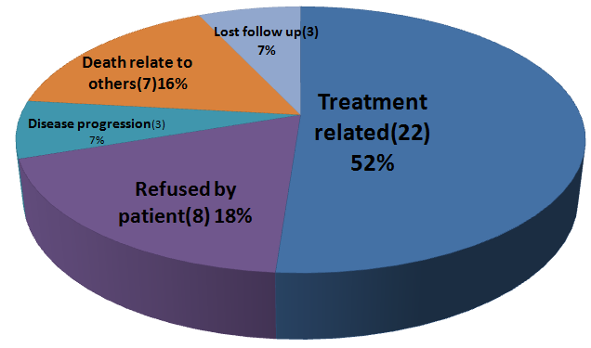
Early treatment failures
Toxicities(4)
18%
Death(18)
82%
Notes:
This slide shows the etiology of early treatment failure. As you can see, treatment related event , accounting for more than fifty percent, is the major cause of early treatment failure. The next is refusing by patient. In the treatment related event, eighty percent is treated related mortality

Slide 23
ORR:72%
OCR: 39 %
Notes:
Response assessment is available for ninety eight patients in protocol treatment group. The overall response rate (ORR) was seventy-two pecnet a, overall complete response is thirty-nine percent.Grade three to four toxicities are common during treatment, around fifty to sixty percent occurred in R-CHOP and R-COP.

Slide 24
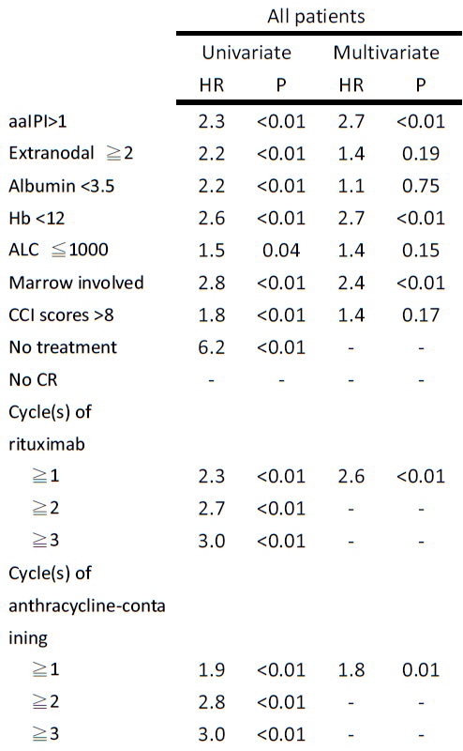
Prognostic facotr in all patients
For all patients
Significant prognostic factor in multivariate analysis:
aaIPI:2-3
Hb<12
Marrow involement
No treatment
Notes:
Next, we investigate the prognostic factor in all patients group. As this slide shows, these are significantly prognostic factors in the univariate analysis. After corrected by multivariate analysis, the significantly poor prognostic factor for all patients are higher aaIPI, anemia, marrow involvement and no treatment

Slide 25
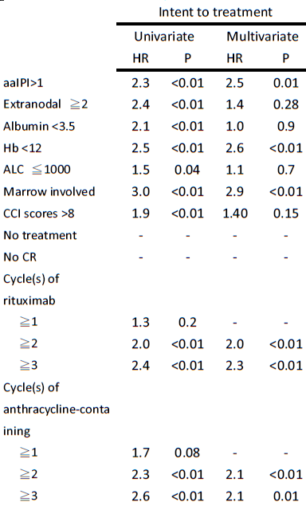
Prognostic factor in ITT
For intent to treatment
Significant prognostic factor in multivariate analysis:
aaIPI:2-3
Hb<12
Marrow involvement
Rituximab or Anthracycline contained therapy used ≧ 2 cycles
Notes:
Lets move on to the intent to treatment and focus on the cycles of rituximab and anthracycline. This symbol of more than one is indicated the hazard ratio of no rituximab versus receiving more than or equal to one cycle of rituximab and the symbol of more than two is indicated the hazard ratio of less than two cycles of rituxiamb verus more than or equal to two cycles rituxiamb. It is so on the anthracycline contained theapy. As this table shows, in univariate analysis, there is no significant prognosis in patietns with more than one cycle of rituximab or anthracycline contained therapy. What we talk about to is the beneficial threshold of rituximab or anthracycline contained therapy is more than or equal to two cycles.
In the multivariae analysis, the significant prognostic factors are similar with all patients, just mentioned in previous slide. Such as aaIPI, anemia and marrow involvement. Then, I d like to emphasize the survival benefit may result from receiving more than or equal to two cycles of rituximab or anthracycline contained therapy.
This is patients receiving more than one cycle of rituximab versus without rituximab. As this table shows, there is no significant difference in rituximab

Slide 26
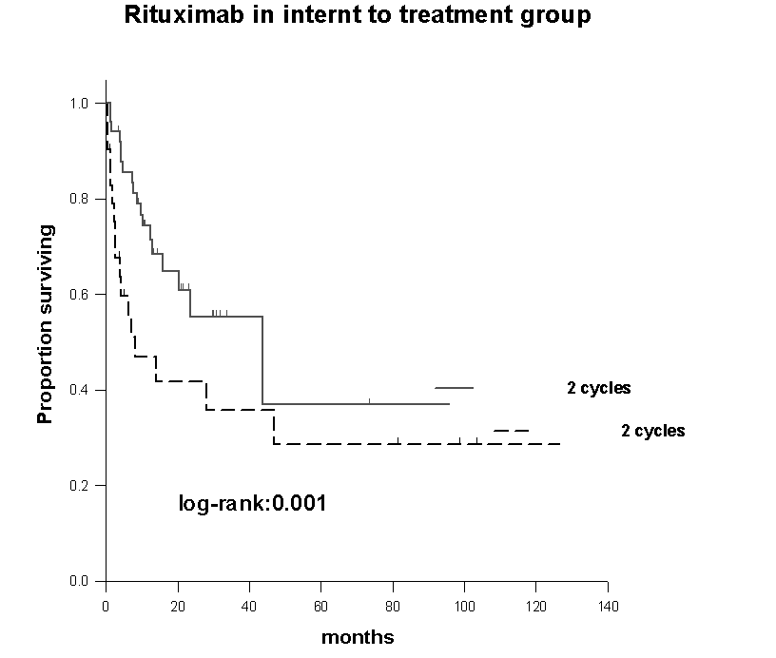
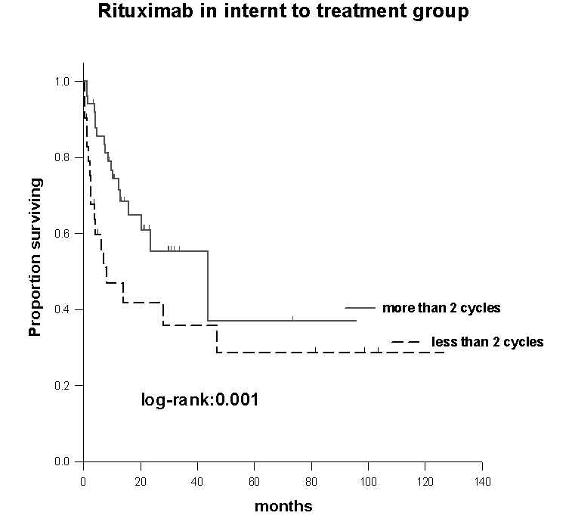
≥
<
Notes:
This is the survival curve of rituximab in intent to treatment group. As your can see, the survival of more than or equal to 2 cycles is superior to less than 2 cycles

Slide 27
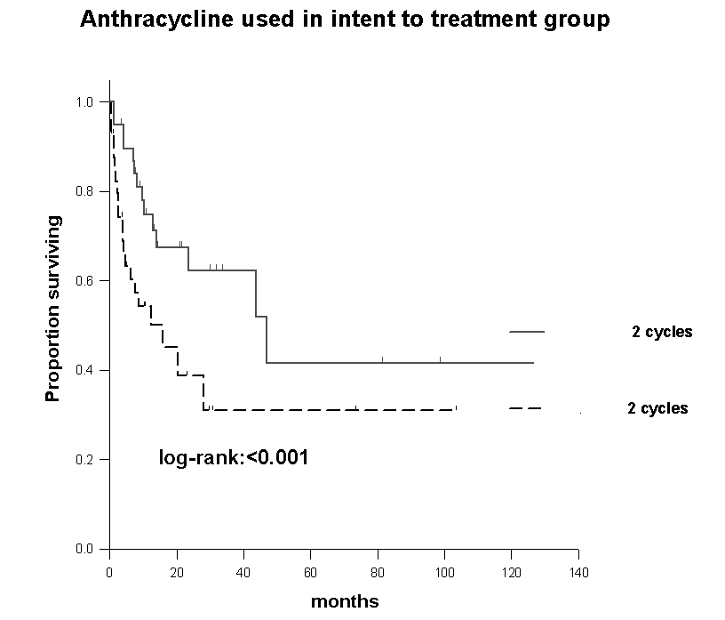
≥
<
Notes:
And its so on anthracycline contained thearpy

Slide 28
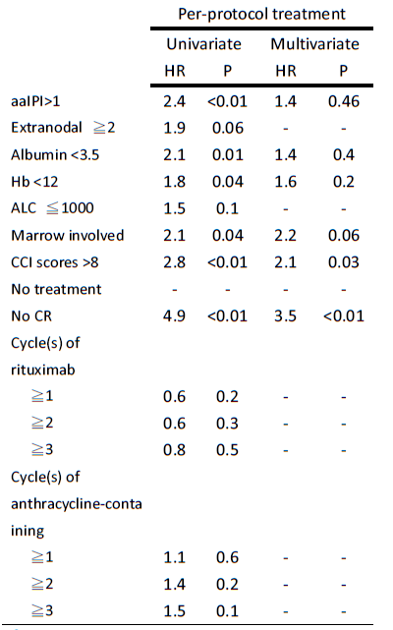
Prognostic factor in PPT
For per-protocol treatment
Significant prognostic factor in multivariate analysis:
Charlson score index >8
No complete response
Notes:
Finally in the per-protocol treatment group. The significant prognostic factor in multvariate analysis are higher charlson score and no complete response to induction therapy

Slide 29
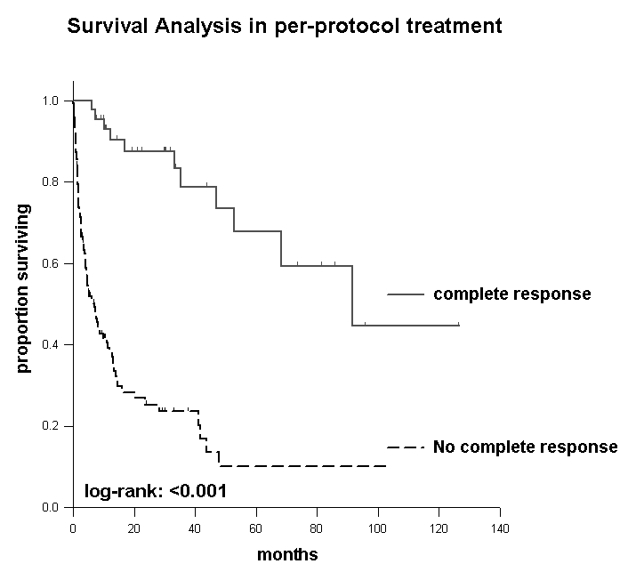
Notes:
the survival of complete response is superior to no complete response

Slide 30
Discussion/conclusion
15% of very elderly DLBCL patients DID NOT receive immuno-chemotherapy and 28% of intent-to-treat patients (i.e., 24% of all patients) had early treatment failure (ETF).
Treatment-related toxicities account for the most cases with ETF(52%).
For ‘very elderly’ DLBCL patients, aaIPI, marrow involvement , Hb level at diagnosis, and treatment or not play important roles in the prognosis
Notes:
I d like to conclude with the flowing two slides, fifteen percent of very elderly diffuse large b cell lymphoma patients did not receive immuno-chemotherapy and twenty-eight percent of intent to treat patients had early treatment failure. Treatment related toxicities account for the most case with early treatment failure. For very elderly diffuse large b cell patients, aaIPI, marrow involvement, hemoglobulin at diagnosis, and treatment or not play the most important role in the prognosis

Slide 31
Conclusion/Discussion
For ‘intent to treatment’ patients, administration ≥ 2 cycles of Rituximab
or ≥ 2 cycles of anthracycline containing chemotherapy are associated with a better overall survival .
To improve the prognosis of these frail patients, the initiation of the prospective study to determine appropriate cycles of rituximab and anthracycline is highlighted.
Notes:
For intent to treatment patients, administration more than or equal to two cycles of rituximab or antrhacycline contained therapy were associated with a better overall survival. To improve the prognosis of these frail patients, the initiation of the prospective study to determine appropriate cycles of rituximab and anthracycline is highlighted
Associate /determine /appropraite /

Slide 32
The limitation of our study
Retrospective analysis: additional efforts to collect the information about
Dose reduction of chemotherapeutic agents, especially for anthracycline
Inter-cycle delay
Initiation of G-CSF use following chemotherapy and prophylaxis of infection varies and was dependent on the physicians in charge
Updated geriatric assessment: not available
The reasons for the final decision of not-to-treat by the patients and family
Notes:
There are some limitation of our study, first because this is a retrosepctive study, it is difficult to evaluate the dose reduction of chemotherapy and inter cycles delay. Second, the effect of G-CSF prophylaxis for infection after chemotherapy is not clear. Third, because it is a cross over more than ten years study, there is no updated geriatric assessment. Finally, the reason why patient refuse therapy is not certainly sure

Slide 33
Thank You
Notes:
That’s all for my presentation. Thank you much

Slide 34
Acknowledgement
Taipei Veteran General Hospital, Taiwan
Department of Medicine,
Division of Hematology and Oncology
Liang-Tsai Hsiao, Yuan-Bin Yu, Chun-Yu Liu, Jyh-Pyng Gau, Jin-Hwang Liu, Po-Min Chen, Cheng-Hwai Tzeng
Division of Transfusion Medicine,
Tzeon-Jye Chiou,
Department of Pathology and Laboratory Medicine
Ching-Fen Yang
Notes:
Ladies and gentlemen. It had been a great pleasure for me to be here with you. Thank you

