Slide 1
Supervisor: VS 高志平
Reporter: R4 張妙而

Slide 2
Introduction
Mutations in nucleophosmin 1 (NPM1) gene, one of the most common gene mutations
(25%-30%) in AML
NPM1^{mut} co-occurs with FLT3, DNMT3A, IDH1, IDH2, and NRAS, not in a random order, instead early and late events

Slide 3
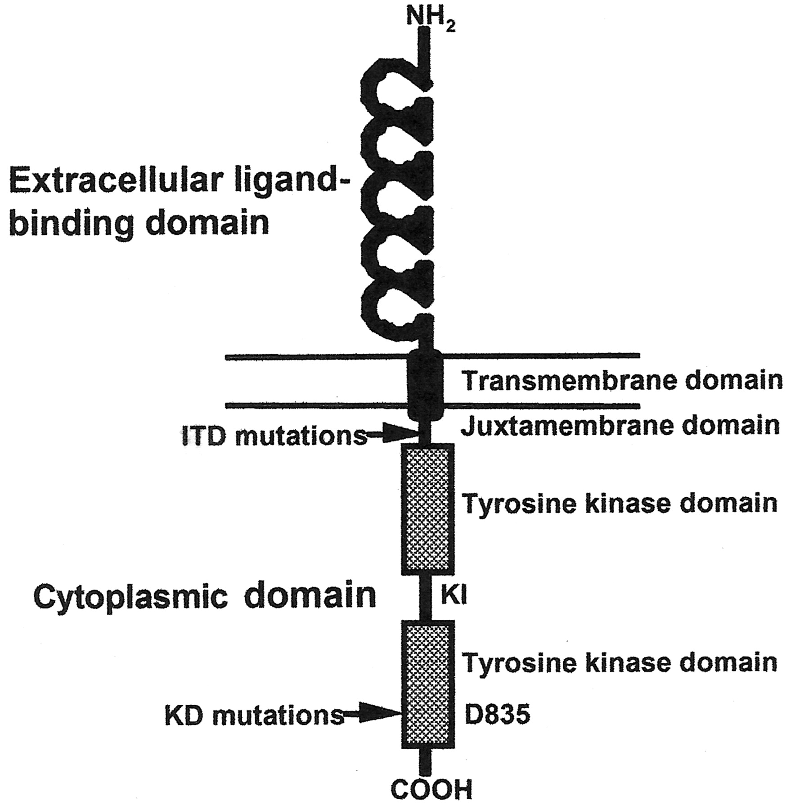
Introduction
A high proportion of NPM1^{mut} AML patients achieve CR with intensive chemotherapy
50% of these patients have relapse during the first 3 years after diagnosis, in particular with concurrent FLT3-ITDs gene

Slide 4
Introduction
NPM1^{mut}, founder event in the pathogenesis of AML, based on stable over time and maintained at relapse, even after a long latency
Loss of NPM1^{mut} in 10% of relapsed patients, accompanied by chromosomal and molecular changes

Slide 5
Introduction
Clonal evolution is a hallmark of cancer, highly affected by cytotoxic therapy, selecting resistant clones, reoccurrence of the disease
To assess clonal evolution in “AML with NPM1^{mut},” the author analyzed paired leukemia samples
at diagnosis and relapse from 53 patients by high-
resolution SNP-array profiling and mutation
analysis of 10 AML-associated genes
SNP: single-nucleotide polymorphism

Slide 6
methods

Slide 7
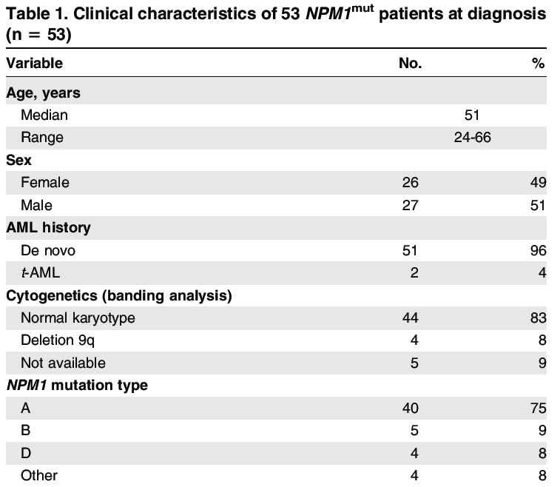
Patients
53 adult AML patients (24-66 y/o)

Slide 8
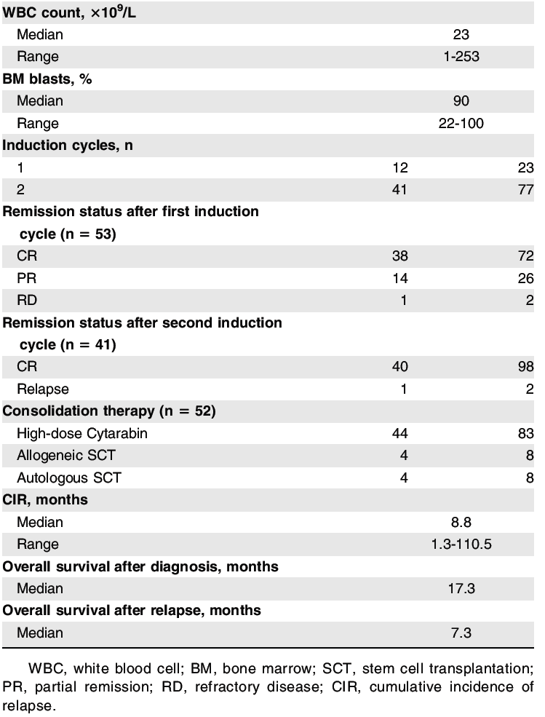

Slide 9
results

Slide 10
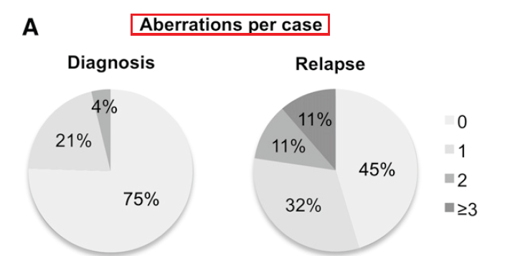
Cytogenetics, CNAs, and UPDs at diagnosis and relapse
CNA: copy number alterations, UPD: uniparental disomies
2/53
6/53
11/53
6/53
17/53
Mean number of abberations 0.28 per case/diagnosis to 1.06 per case/relapse
(paired Student t test, P=0.002)

Slide 11
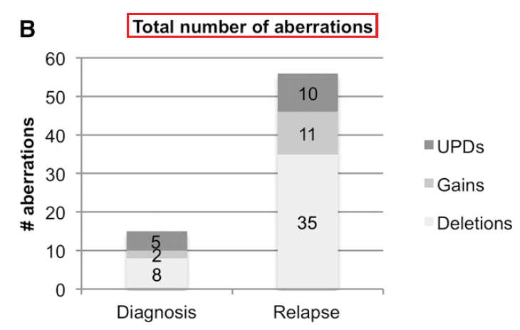

Slide 12
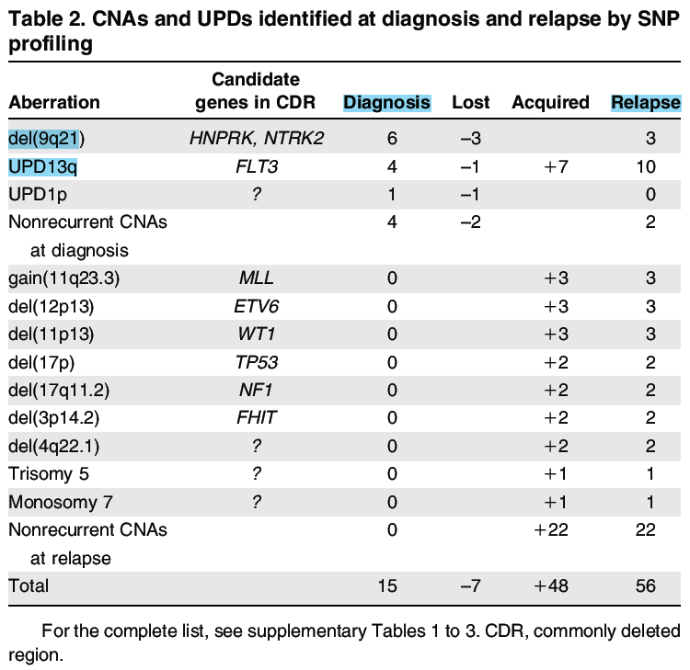

Slide 13
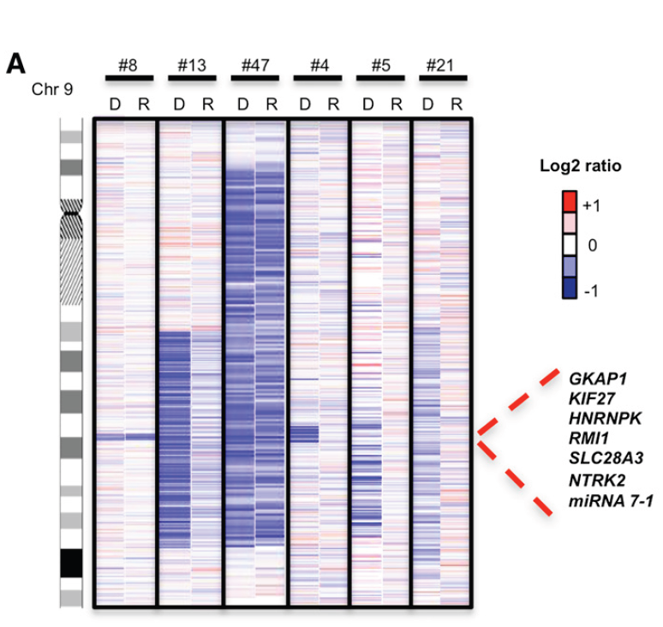
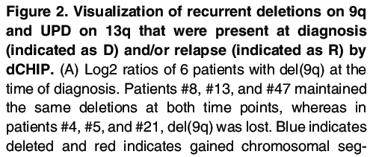
The same
Del(9q) lost

Slide 14
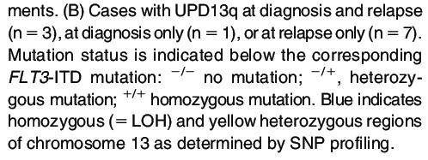
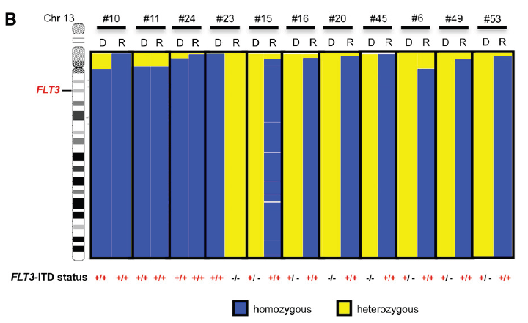
N=3, both
N=1, diagnosis only
N=7, relapse only

Slide 15
Gene mutation pattern at diagnosis and relapse
Stability = mutations persisted in relapse/all mutations in diagnosis
Acquired at relapse = new mutations in relapse/ mutations in diagnosis

Slide 16
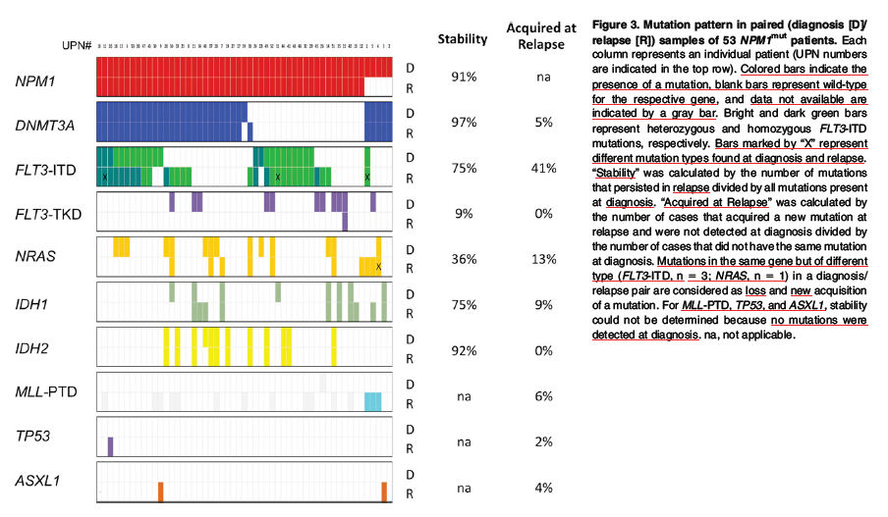

Slide 17
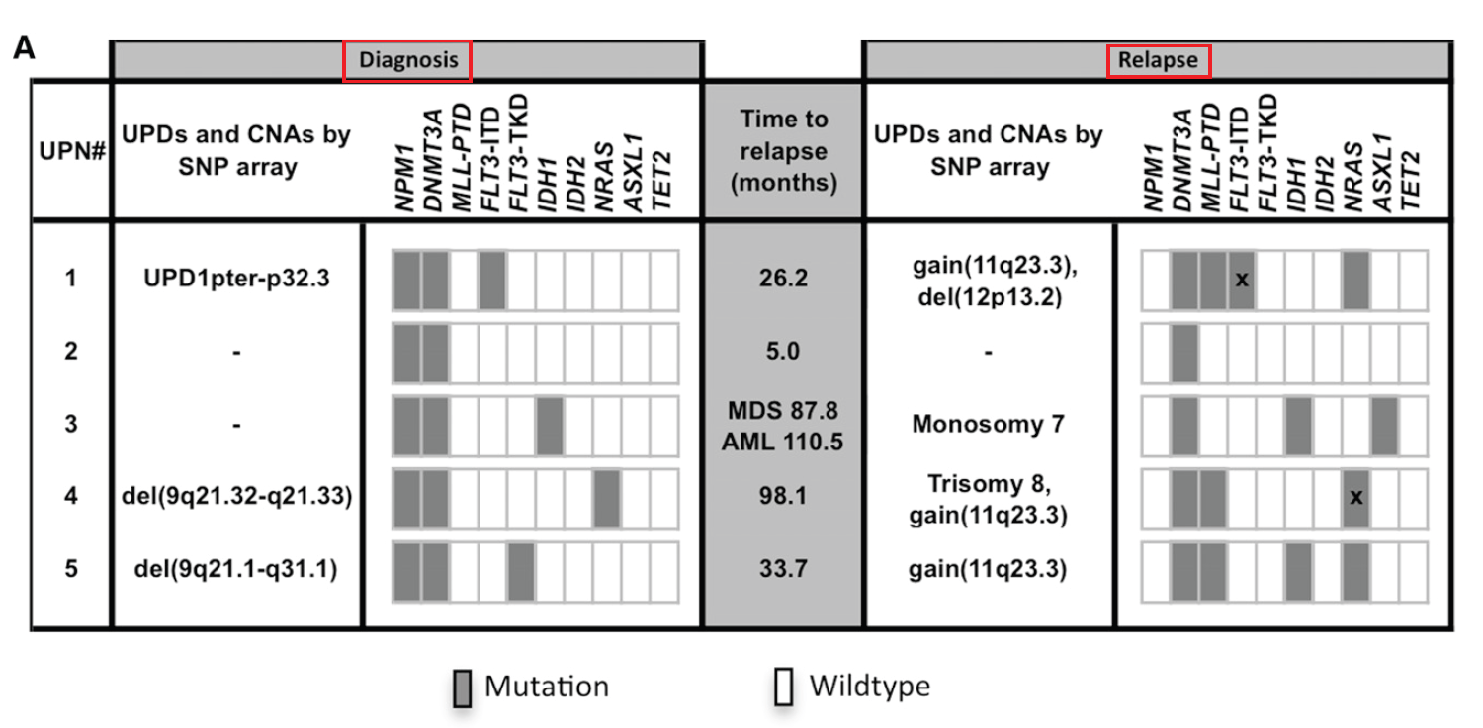
Loss of NPM1 mutation at relapse

Slide 18
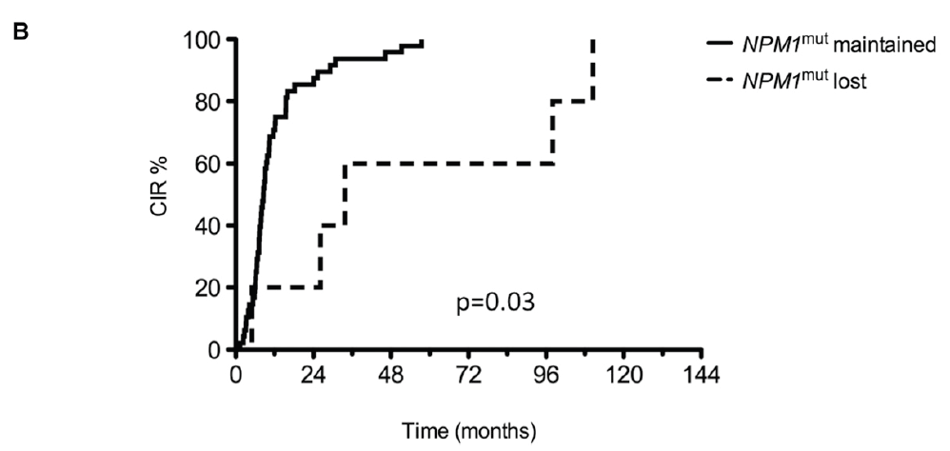
CIR=cumulative incidence of relapse
The median time interval between achievement of CR and relapse in these 5
AML cases was 33.7 months (range, 5.0-110.5 months) and thus
significantly longer than in the 48 patients maintaining the NPM1 mutation
at relapse (median, 8.6 months; range, 1.3-57.4; P=0 .03)

Slide 19
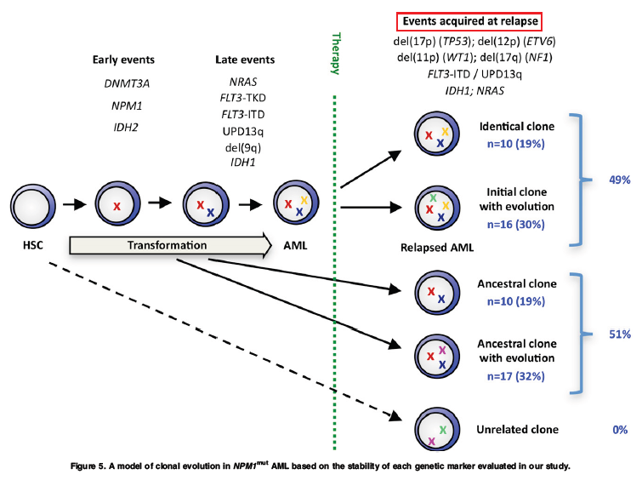
Clonal evolution in NPM1^{mut} AML
Additional aberration
Lost aberration
Newly acquired gene

Slide 20
discussion

Slide 21
High-resolution SNP-array profiling of 53 relapsed NPM1^{mut} AML patients
0.28 aberration/case at diagnosis
1.06 aberration/case at relapse
A higher genetic complexity at relapse is consistent with previous by chromosomal banding analysis

Slide 22
Most of aberrations found at relapse, associated with high-risk AML, part explain the poor outcome of relapsed AML
No evidence for t-AML that derived from a genetically unrelated hematopoietic clone
Primary leukemia and relapse, genetically
related and derive directly from the dominant
leukemic clone or from a common ancestral clone

Slide 23
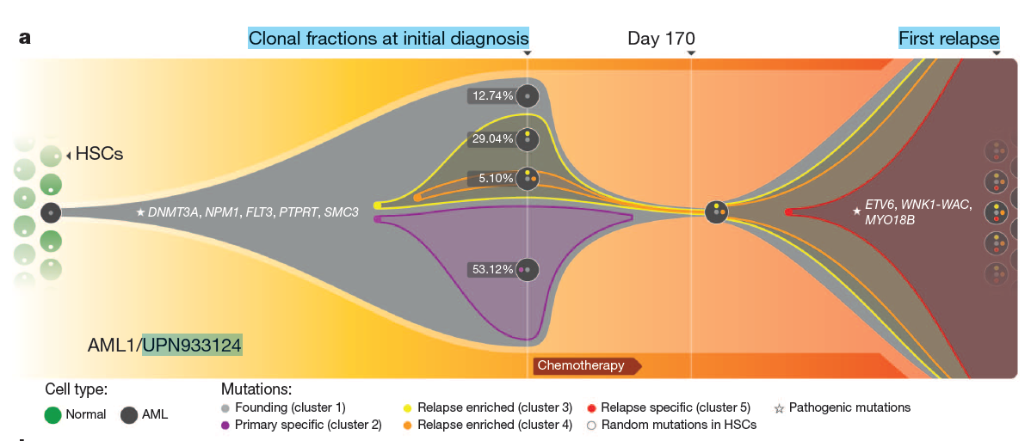
Ding L, Ley TJ, Larson DE, et al. Clonal evolution in relapsed acute myeloid leukaemia revealed by whole-genome sequencing. Nature. 2012; 481(7382):506-510

Slide 24
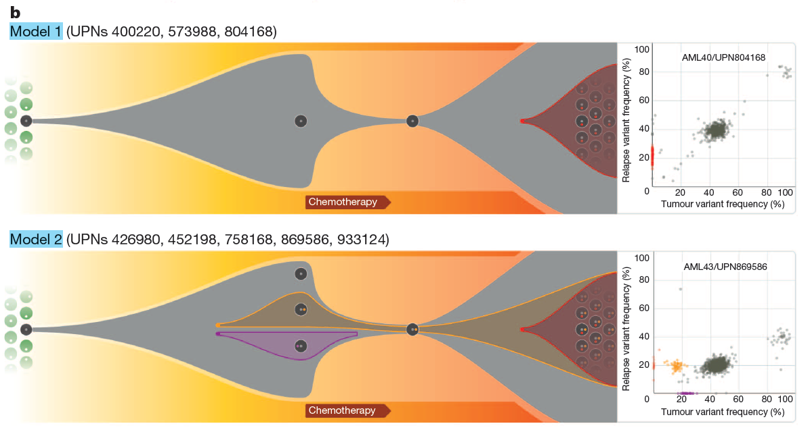
Gain mutations
Survive and expand

Slide 25
DNA-damaging chemotherapy causes secondary genetic changes in persisting (pre-)leukemic clones
The specific alterations exclusively at relapse, such as 27/del(7q) and derivative chromosome (12;17)(q10;q10), are frequent in previously treated with chemotherapy

Slide 26
A marked increase in the number of a specific type of mutation (transversions) in relapsed AML compared with de novo AML
In conclusion, although NPM1^{mut} is generally considered a primary event in NPM1^{mut} AML, the data of this study suggest that mutations in DNMT3A can precede NPM1 mutations.

Slide 27
Persisting subclones or preleukemic HSCs acquire new secondary aberrations rather than being genetically unrelated t-AML
To achieve long-term leukemia-free survival, future therapies in AML need to eradicate
all (pre-)leukemic clones present at diagnosis
that persist during therapy and contribute to
relapse

