Slide 1
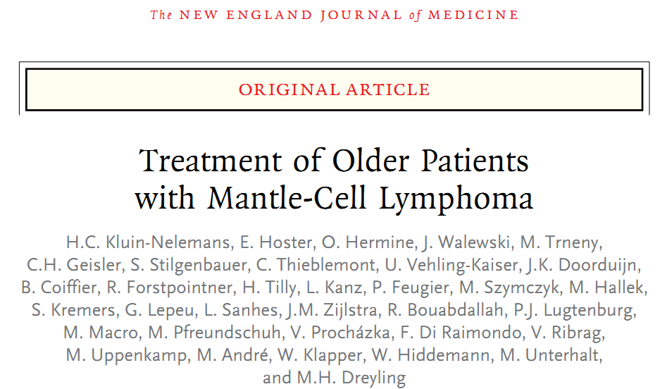
Supervisor: Vs 楊慕華醫師
Presenter: CR 周益聖醫師
N Engl J Med 2012;367:520-31.
Notes:
這一篇是NEJM 2012年發表，治療老年人罹患mantle cell lymphoma (MCL)的臨床試驗

Slide 2
Introduction
Notes:
MCL 有 t(11,14)，在病理下的特徵是小而深染的淋巴球細胞，CD5(+),CD20(+), Cyclin D1(+)

Slide 3
Diagnostic hallmark
CD5+CD23- mature B cell neoplasm
CCND1 gene/cyclin D1 protein overexpression t(11;14)(q13;q32)
WHO classification
Classic: Sox 11 nuclear over-expression
Blastoid (pleomorphic)
Marginal-zone like
Small cell : better prognosis
Notes:
臨床上診斷的要件是
CD5陽性，CD23陰性的成熟B細胞腫瘤
有第11與14對染色體的轉位或是有CCND1 基因或是cyclin D1蛋白質的過度表現
在WHO分類可分為四種

Slide 4
A disease of dismal prognosis
Notes:
MCL 的癒後一向不好，同時有低惡性度淋巴瘤無法治癒的特徵，也同時有高惡性度淋巴瘤快速惡化的特性

Slide 5
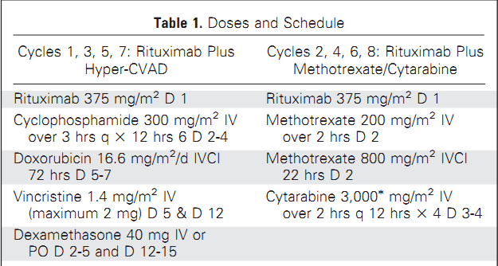
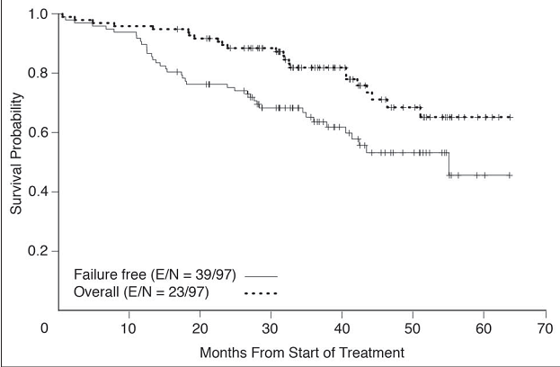
For young MCL…( median age of 60)
CR/CRu:87%
(75/97 with CR and 9/97 with CRu)
J Clin Oncol 23:7013-7023.
Notes:
MD anderson曾經發表使用R-HyperCVAD的regimen來治療MCL，完全緩解率可以高達87%

Slide 6
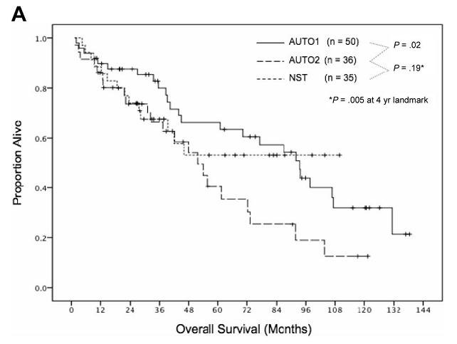
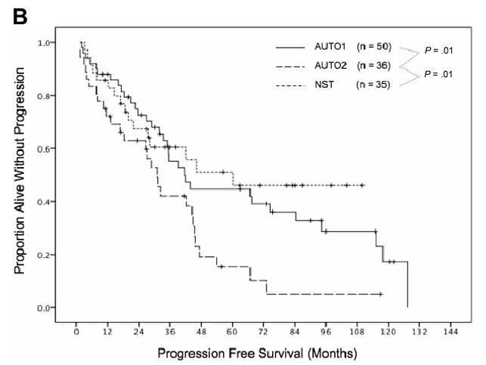
Upfront transplant?
Allogenic → long term cure with unaccetable TRM of 40%
Auto→ no OS or PFS plateau
Blood. 2009;113:4144-4152
Notes:
在第一線化療結束之後使用異體移植雖然可以達到長期治癒的目標，但是其治療的死亡率高達40%
在第一線化療結束之後使用自體移植則無法達到長期治癒
TRM in NST: non myeloablative SCT→ 40%

Slide 7
EBMT recommendations for MCL
 | MSD | MUD | Mismatched | Auto
CR1 (intermidiate/high risk) | CO | D | GNR | S
Chemosensitive, >=CR2 | CO | D | GNR | S
Refractory | D | D | GNR | GNR
EBMT handbook, 6th editon, 2012
Notes:
目前歐洲骨髓移植學會的建議是在高危險群第一次達到緩解或是第二次達到緩解且對化療有反應作自體移植
但是親屬程植也是可以考慮的選擇( clincal option)

Slide 8
Semin Hematol 2011;48:194-207
Notes:
如果是年輕的MCL病人，目前建議用R-HyperCVAD作引導性治療，再用自體或異體移植作鞏固性治療( 考量病人的復發風險程度)，再用莫須瘤作維持性治療

Slide 9
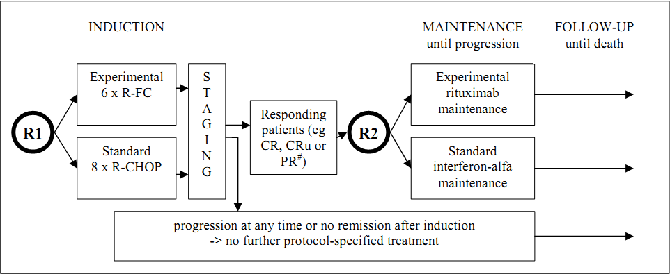
Schema
Notes:
這個臨床試驗作兩次隨機分組，第一次分為 6次的R-FC,或是8次的 R-CHOP，之後作一次效果的評估，再作第二次隨機分組，一組用莫須瘤維持治療，另一組用干擾素維持治療

Slide 10
Inclusion criteria
newly diagnosed mantle-cell lymphoma
Ann Arbor stage II to IV
66 years of age or older or 60 to 65 years of age if ineligible for high-dose treatment
ECOG of 2 or less
Notes:
納入條件: 新診斷MCL，Ann-Arbor 第二到第四期，66歲以上或是介於60-65歲但是無法接受高劑量化學治療及自體移植，生活功能不能太差

Slide 11
Exclusion criteria
WBC count< 2 x 10⁹ /L
Platelet < 100 x 10⁹ /L
Liver-enzyme greater than 3 times ULN
Total bilirubin greater than 2.5 times ULN
Cr greater than 2 times ULN
Involvement of the central nervous system
History of autoimmune cytopenia
Hypersensitivity to murine antibodies
Other cancers
Serious cardiac, pulmonary, neurologic, or endocrine disease
Notes:
排除條件: 白血球<2000，血小板<100k，肝臟功能大於3倍，黃疸大於2.5倍，腎功能大於2倍，侵犯到中樞神經，有自體免疫疾病，對抗體過敏

Slide 12
Treatment
R-FC Q28D x 6 cycles
Rituximab 375 mg/m² IVA
fludarabine 30 mg/m² IVA Day1-3
Cyclophosphamide 250 mg/m² IVA Day1-3
R-CHOP Q21D x 8 cycles
Rituximab 375 mg/m² IVA
Cyclophosphamide 750 mg/m² IVA
Doxorubicin 50 mg/m² IVA
Vincristiine 1.4 mg/m² IVA
Prednisone 100 mg PO D1-5
Rituximab maintanance Q2M until progression
Rituximab 375 mg/m² IVA
Notes:
R-FC 和 R-CHOP 的 治療劑量

Slide 13
Study end points
Primary end point for the comparison of the induction regimens
complete remission rate (excluding unconfirmed complete remissions)
Primary end point for the comparison of maintenance regimens
the duration of remission
Secondary end points
overall response rate
time to treatment failure (defined as stable disease, relapse, progression, or death) from the start of induction therapy
overall survival
toxic effects
Notes:
主要試驗目標是完全緩解率及比較維持治療達到緩解的時間，次要試驗目標是反應率，到治療失敗的時間，總存活率，毒性效果

Slide 14
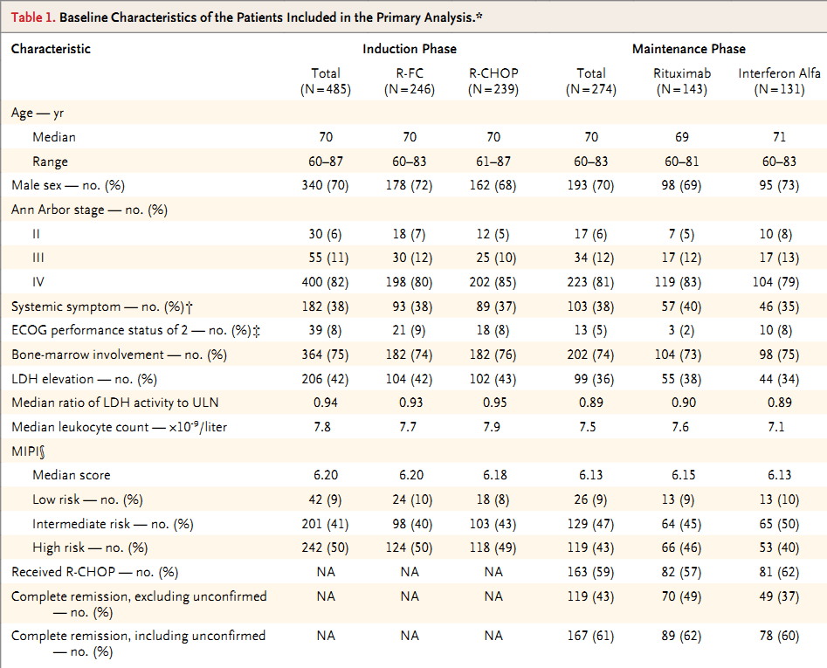
Notes:
病人的年紀中位數在70歲，8成是Ann Arbor 第四期，9成屬於中高危險群

Slide 15
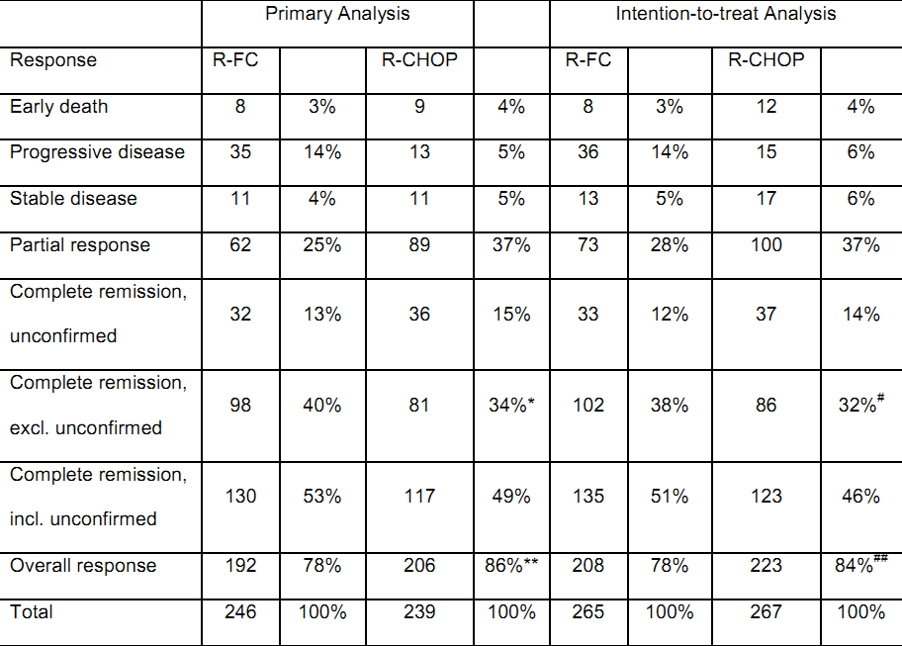
Response
Notes:
完全反應率在R-FC是40%，在R-CHOP是34%，有統計學上的意義，另外總反應率在R-FC這組是78%，在R-CHOP是86%，也有統計學上的意義

Slide 16
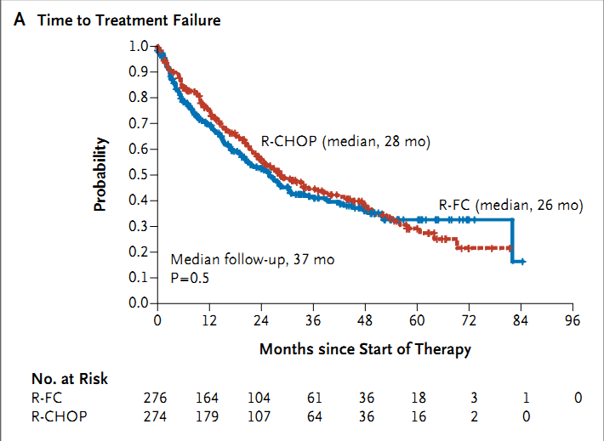
Induction
Notes:
R-CHOP與R-FC在到達治療失敗的間並沒有差別，但是總存活則是R-CHOP ( 67 個月)比R-FC (40個月)好，P值是0.005

Slide 17
Cause of death
 | RCHOP | RFC
Progression of lymphoma | 47 | 64
Infection | 12 | 19
Secondary cancer | 3 | 9
Cardiac causes | 9 | 4
Pulmonary causes | 2 | 3
CNS bleeding or ischemia | 1 | 2
Leukoencephalopahty | 1 | 1
Unknown | 9 | 13
Notes:
最主要的死因是因為淋巴瘤的惡化，次之為感染

Slide 18
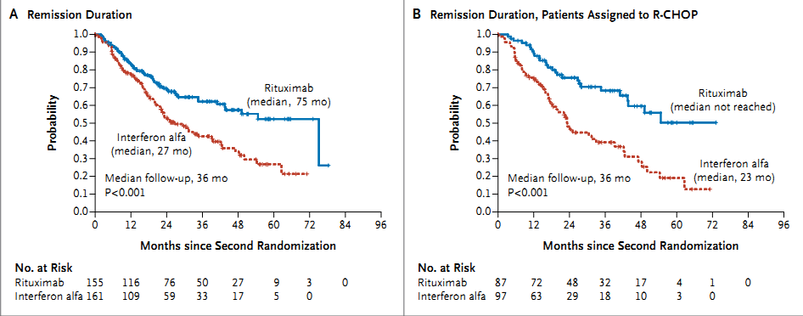
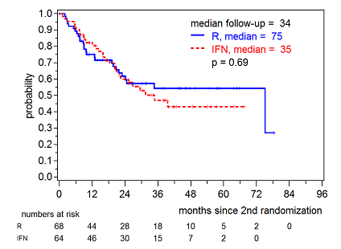
Remission
duration
Notes:
在維持治療達到緩解的時間，莫須瘤( 75個月)也比干擾素( 27個月)來得好，一開始使用R-CHOP作引導性治療，之後用莫須瘤會比干擾素好，如果一開始用R-FC，則之後用莫須瘤則跟干擾素沒有統計學上的差異

Slide 19
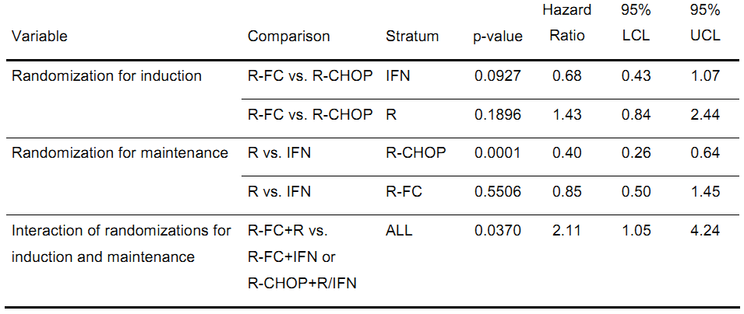
Remission duration
Notes:
一開始使用R-CHOP作引導性治療，之後用莫須瘤會比干擾素好，可以降低60%的風險，如果一開始用R-FC，則之後用莫須瘤則跟干擾素沒有統計學上的差異
R-FC後用莫須瘤維持治療則有統計學上意義的害處，死亡風險高達2.11倍

Slide 20
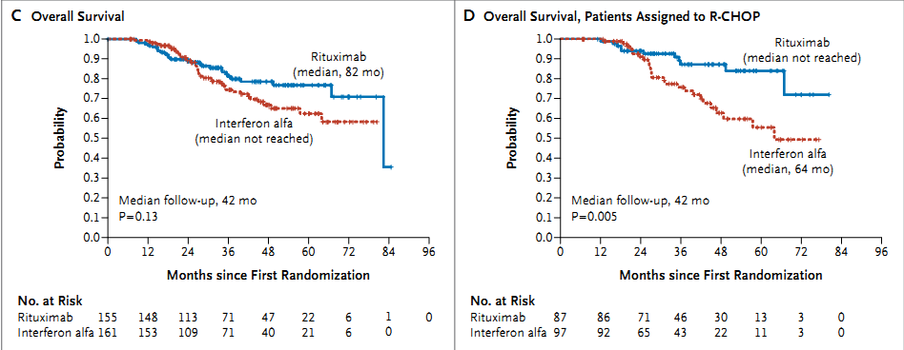
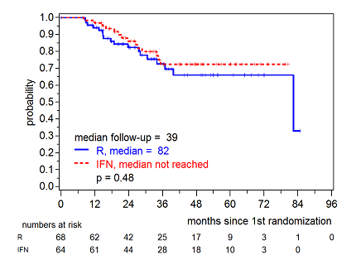
Overall
Survival
Notes:
就全部病人而言，雖然莫須瘤比干擾素好，但沒有統計學上的差異
但就一開始使用R-CHOP作引導治療的病人而言，莫須瘤比干擾素好，p=0.005

Slide 21
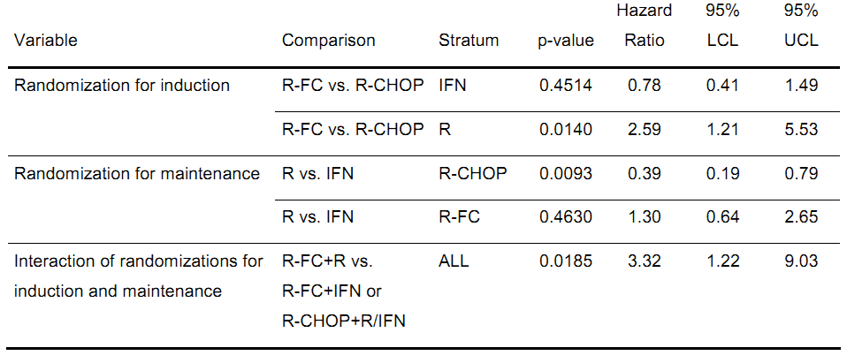
Overall Survival
Notes:
就之後用莫須瘤維持治療的病人而言，引導治療用R-FC的死亡風險是R-CHOP的2.59倍
就一開始用R-CHOP作引導治療的病人而言，用莫須瘤作維持治療跟干擾素比較起來可以降低7成的死亡率

Slide 22
Side effects

Slide 23
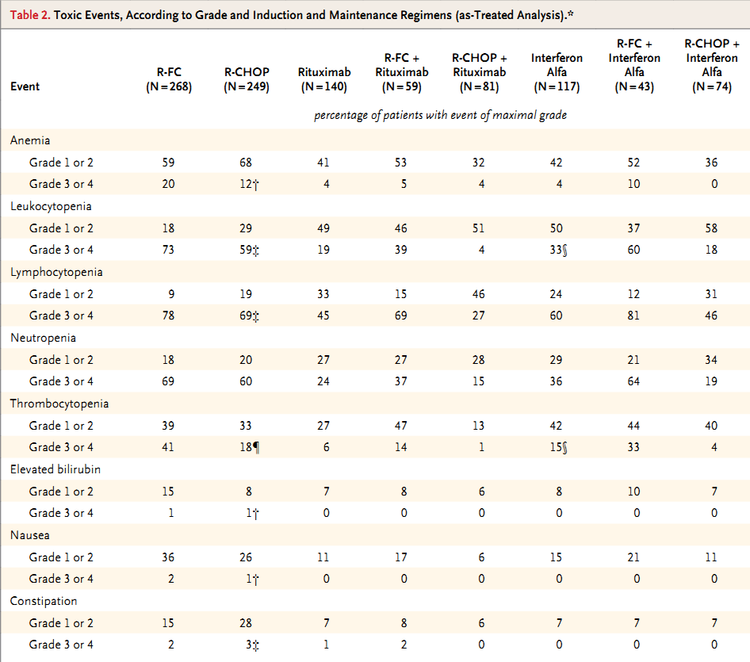
Notes:
另外在血液學上的毒性，R-FC都比R-CHOP來得高

Slide 24
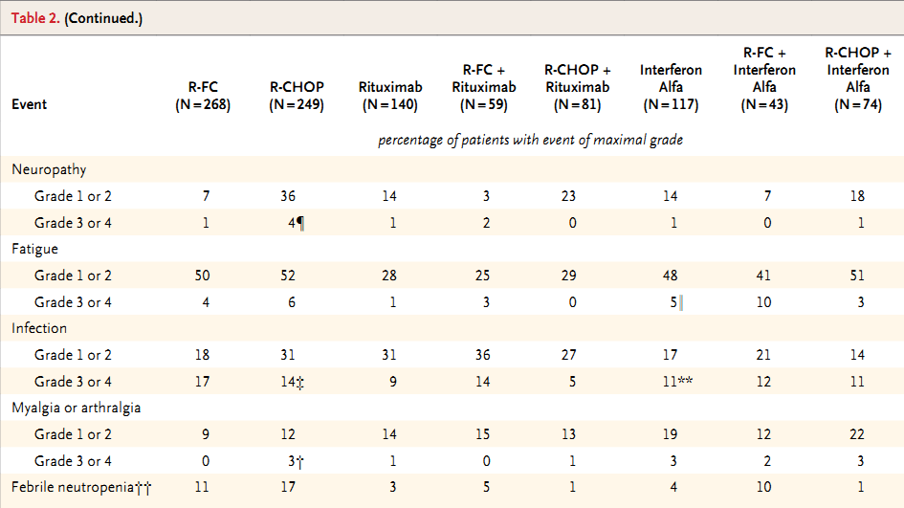
Notes:
在神經學毒性和嗜中性球低下發燒的副作用而言，R-CHOP這一組比較多

Slide 25
Discussion

Slide 26
Why not RFC?
The increase in early progressions was unexpected and resulted in more deaths in combination with more toxic events
the poor performance of the R-FC regimen itself
insufficient hematopoietic recovery during and after the induction phase
not considered suitable for patients who were older than 70 years of age or who had two or more coexisting conditions
Notes:
使用R-FC這一組反而病人會提早惡化且造成更多的死亡與副作用，可能與R-FC的療效差有關係，但也有可能是因為試驗的設計在引導治療時沒有足夠的時間讓血球長回來所導致
所以在年紀大於70歲的病人或是有兩種以上的共病時，R-FC是不適合的。

Slide 27
RCHOP better than RFC due to more exposure of rituximab?
Possibly due to more dose-dense rituximab in RCHOP arm
Q21D x8 cycles in RCHOP vs Q28D x6 cycles in RFC
The authors assumed that the resulted difference would be inconsequential
Notes:
R-CHOP比R-FC好是不是因為病人在這一組會接受比較多的莫須瘤?作者覺得這個差別並不足以改變試驗的結果

Slide 28
Rituximab maintenance
Continue until progression based on the poor outcome of salvage treatments in patients with relapsed mantle-cell lymphoma
Significant PFS and OS benefit in patients pretreated with RCHOP
Notes:
在這個試驗的設計，莫須瘤的維持治療是持續直到腫瘤惡化才停止，主要是因為MCL一旦復發，之後治療的效果奇差無比，而在此試驗也證明對一開始使用R-CHOP作引導性治療的病人，莫須瘤的維持治療有總存活率和無惡化存活率的好處

Slide 29
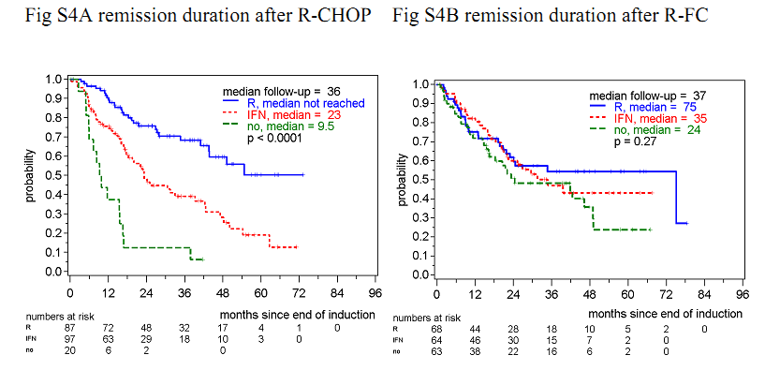
Rituximab better due to poor performance of IFN?
the results with interferon alfa are better than or in line with those of previous trials
a decrease in progression-free survival associated with interferon alfa has not been reported from any trial
The duration of remission and overall survival time after a response to R-CHOP were significantly shorter among patients who were not assigned to any maintenance therapy as compared with IFN
Notes:
作者也發現雖然一開始使用R-CHOP作引導性治療，但如果之後沒有用莫須瘤作維持治療，它的惡化速度會比用干擾素更快

Slide 30
Conclusion
Fludarabine-containing induction regimen was not more effective but was more toxic than R-CHOP
Maintenance therapy with rituximab almost doubled the duration of remission in patients who had a response to induction therapy and significantly improved overall survival among patients who had a response to R-CHOP
Notes:
結論是R-FC 並沒有 R-CHOP 療效來得好，但是毒性比較大
之後用莫須瘤作維持治療，可以讓緩解的時間幾乎變成兩倍，也可以讓一開始對R-CHOP有效果的病人有總存活上的好處

Slide 31
Thanks for your attention!

